Slide 1
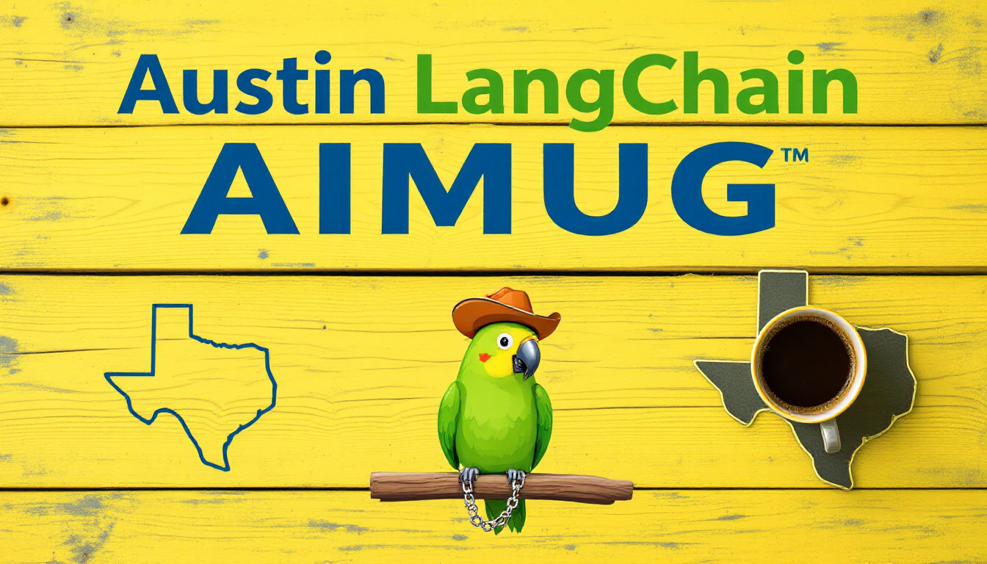


6:20 PM Start Time!!!!

Slide 2

Todays Agenda
Intros
AIMUG Independence Day
News – LangChain Ambassadors Meeting
Lightning Talks – Fastlane Worker
Lightning Talk – Cloudflare Containers
Lightning Talk – Cursor AI Slack Integration
Thunderstorm Talk – EmoJourn – LangChain Project
Showcase – AI Software Testing
Wrap up and after party upstairs at The Tavern

Slide 3
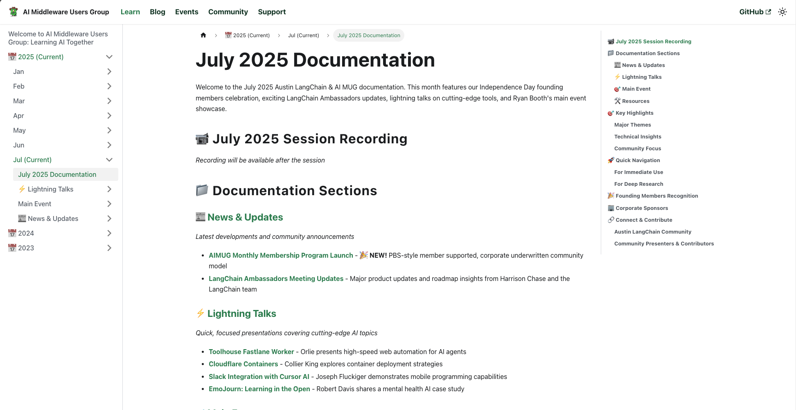
Open AIMUG.ORG – Docs – July 2025
Aimug.org
Learn
July 2025

Slide 4

AIMUG - Member Supported
Cameron Rohn | Jeff Linwood | Robert (Muzz) | Ryan Booth
Christopher Ewing | John Van Lowe | Nate Little | Sal Castoro
Colin Best | Joseph Fluckiger | Orlando Kalossakas | Scott Askinosie
Colin McNamara | Kaiwalya Joshi | R Sarasa | Wendy Schorn
Collier King | Karim Lalani | Riccardo Pirruccio | Zack Angelo
Hutch Enbach | Miguel Lucero | Roberto Fuentes

Slide 5
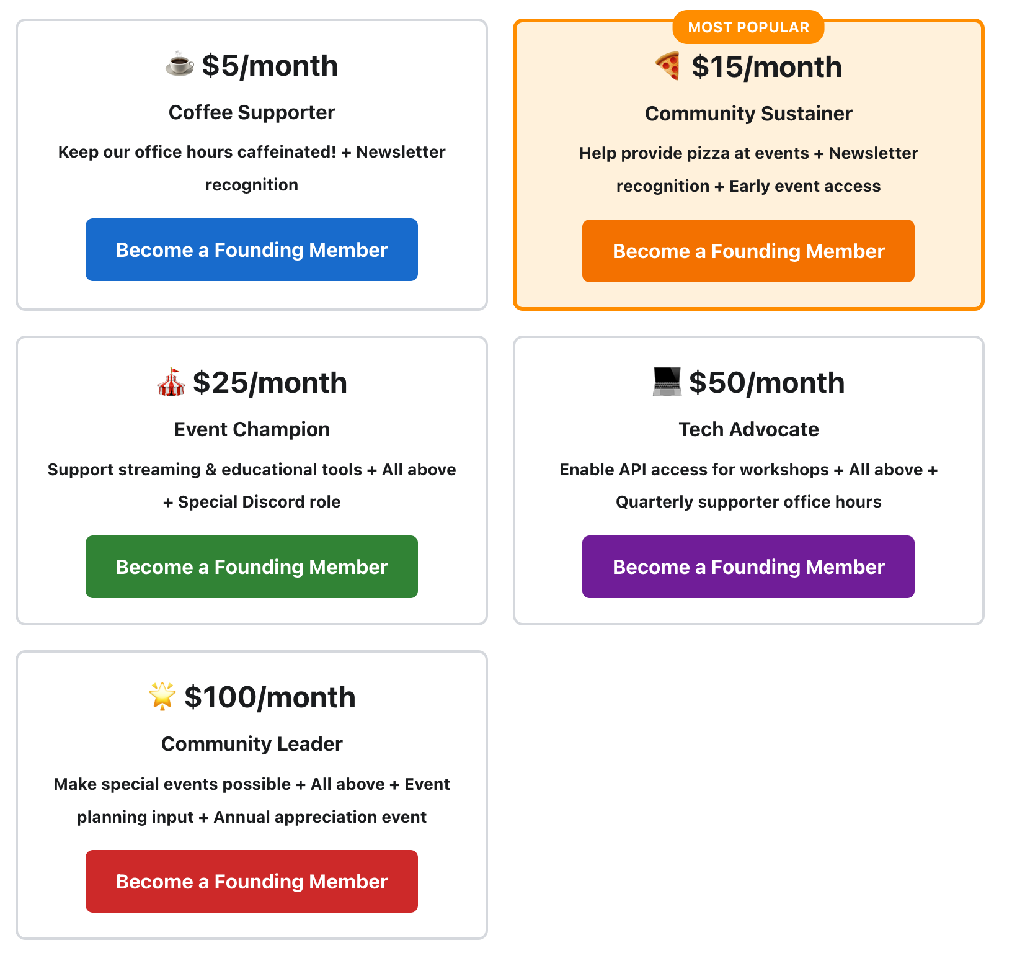
AIMUG – Independence Day Drive

Slide 6

Corporate Underwriters
Center for Government and Civil Services
LangChain AI
Always Cool AI

Slide 7

HI , I’m Colin McNamara
Entrepreneur: Co-founder of Always Cool AI Focusing on Ethical AI across industries such as private-label products and health-conscious goods (LangChain User)
Founding Member: Austin LangChain AIMUG
50% Developer Consulting Engineer, Cloud Builder, Casual Coder
Public Good: Helping our community succeed
LinkedIn:

Slide 8
Who we are
1300+ Members Strong: Connecting Austin’s tech, creative, and business leaders passionate about AI.
Learning in the Open: Leaning AI through the Lense of LangChain, pulling the ecosystem together.
Supportive & Engaged Community: A well-balanced Discord that’s "useful, but not overwhelming."

Slide 9
Learning in the Open – "Be Cool to Each Other" ✌️
Respect & Inclusivity: Our only rule is simple: “Be cool to each other, don’t be gross.”
AI Enthusiasts of All Levels Welcome: We celebrate diverse perspectives and unique paths in AI.

Slide 10
Where and when we meet 🌟📅
Monthly Showcases, Labs & Mixer - ACC RGC3000: Community members and vendors share projects, demos, and labs for hands-on learning.
Hacky Hours (ad hoc) - Rotating Local Bars: Informal happy hours at local spots; meet, discuss, and relax.
Weekly Virtual Syncs - Online: Tuesdays at 5PM – Workshopping, problem-solving, and AI discussions.

Slide 11
Where to Connect & Stay Updated 📲
Website: aimug.org – All things LangChain and AIMUG.
Discord: Join us for ongoing conversations.
GitHub: Austin LangChain Repo – Check out our open-source projects.
Meetup: Austin LangChain Group
Twitter: @AustinLangChain – Latest updates and AI news.
YouTube: Austin LangChain Channel – Watch replays and tutorials.

Slide 12
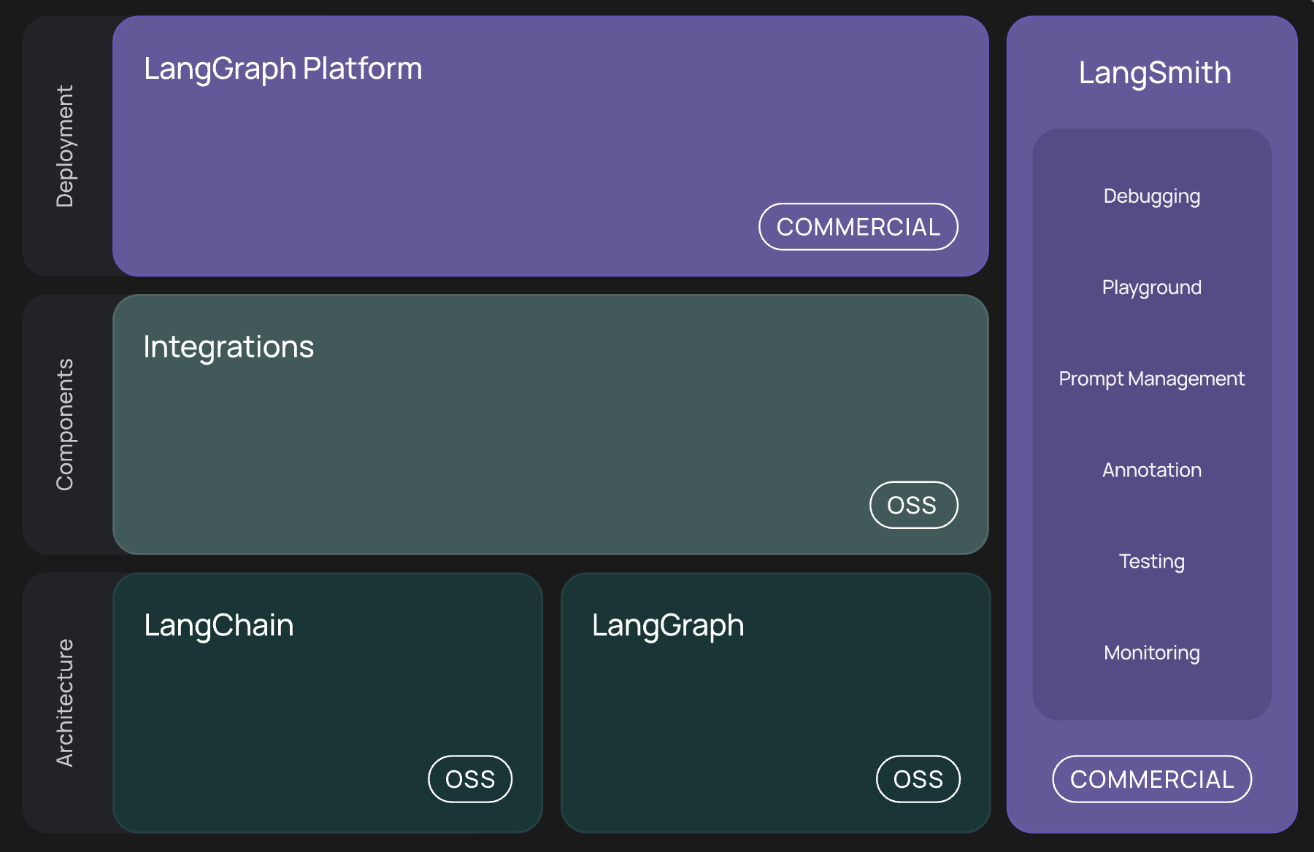
WTF is LangChain ?

Slide 13
🚀 LangGraph 1.0 - Coming Soon
Enhanced Type Safety: Better type hinting and configuration management
Improved Pre-builts:
"Create React Agent" being renamed to "Create Agent"
Better supervisor and swarm implementations
Production Insights: Automated clustering and trace analysis
Smoother Developer Experience: Addressing friction points and papercuts

Slide 14
🔧 LangChain 1.0 - Next Generation
Standardized I/O: Universal input/output formats for all LLM providers
Enhanced Outputs: First-class support for citations, reasoning, and image generation
Better Integration: Improved stability across all integration packages
Seamless Developer Experience: Reducing complexity and improving performance

Slide 15
LangSmith - New Compliance & Features
✅ GDPR Compliance: Now fully implemented
Multi-modal Support: Enhanced token management for various content types
Trace Discovery: Working on clustering and summarization features
LM-as-Judge Workflows: Easier setup for automated evaluation
Production Analytics: Better insights and monitoring capabilities

Slide 16
🤖 New Tools & Platforms
Deep Research Examples: Advanced research agent implementations
Async Coding Agent: Cloud-hosted development assistance (similar to Codex)
Open Agent Platform: Community-driven agent development
MCP Server Integration: Better development environment support
Voice Application Support: Reference templates for TTS/STT integration

Slide 17
🏢 Security Certifications & Enterprise Focus
Compliance Achievements:
SOC 2 Compliant ✅
HIPAA Compliant ✅
GDPR Compliant ✅
Enterprise Initiatives:
Reference Architectures: Discussion ongoing for FedRAMP and deployment patterns
Design Partnership Program: Seeking partners for optimization features
Industry-Ready Solutions: Strong compliance posture for regulated industries

Slide 18
👥 Community-Driven Development
Ambassador Program: Active feedback integration from developer community
Developer Onboarding: Improved documentation and Cursor integration support
Open Source Focus: Community contributions and collaborative development
Design Partnerships: Working directly with users on optimization features

Slide 19
🎯 Strategic Direction for 2025
Stability Focus: Minimizing breaking changes while adding powerful features
Community-Driven: Active feedback integration from ambassador program
Enterprise-Ready: Strong compliance posture for regulated industries
Developer Experience: Significant investments in tooling and documentation
Platform Maturity: Evolution into comprehensive AI development ecosystem

Slide 20
💡 Impact on Development Workflow
Faster Development: Improved tooling and pre-built components
Better Debugging: Enhanced tracing and analytics in LangSmith
Enterprise Adoption: Compliance features enable broader organizational use
Community Resources: More examples, templates, and community-driven tools
Future-Proof: Stable APIs with backward compatibility focus

Slide 21
Lightning Talks!
Fastlane Worker - Orlie
CloudFlare Containers – Collier
Slack + Cursor – Joseph
EmoJourn – LangChain learning - Robert

Slide 22
Lightning Talks!
Fastlane Worker - Orlie

Slide 23
Lightning Talks!
CloudFlare Containers – Collier

Slide 24
Lightning Talks!
Slack + Cursor – Joseph

Slide 25
Lightning Talks!
EmoJourn – LangChain learning - Robert

Slide 26
Showcase
MCP Tox Testing (or more) – Ryan Booth

Slide 27
Showcase – Ryan Booth
MCP Tox Testing – Ryan Booth

Slide 28
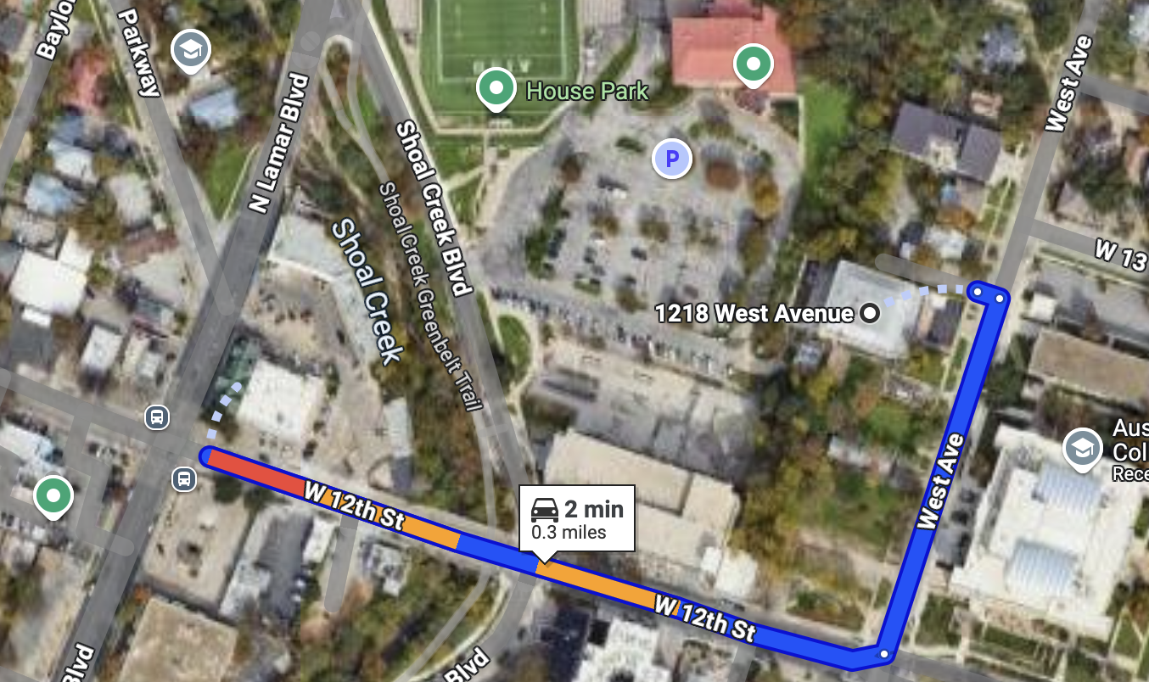
RGC-3000 and Tavern After Party
Website: aimug.org – All things LangChain and AIMUG.
Discord: Join us for ongoing conversations.
GitHub: Austin LangChain Repo – Check out our open-source projects.
Meetup: Austin LangChain Group
Twitter: @AustinLangChain – Latest updates and AI news.
YouTube: Austin LangChain Channel – Watch replays and tutorials.
ACC RGC3000
The Tavern
ACC Main Campus

Slide 29
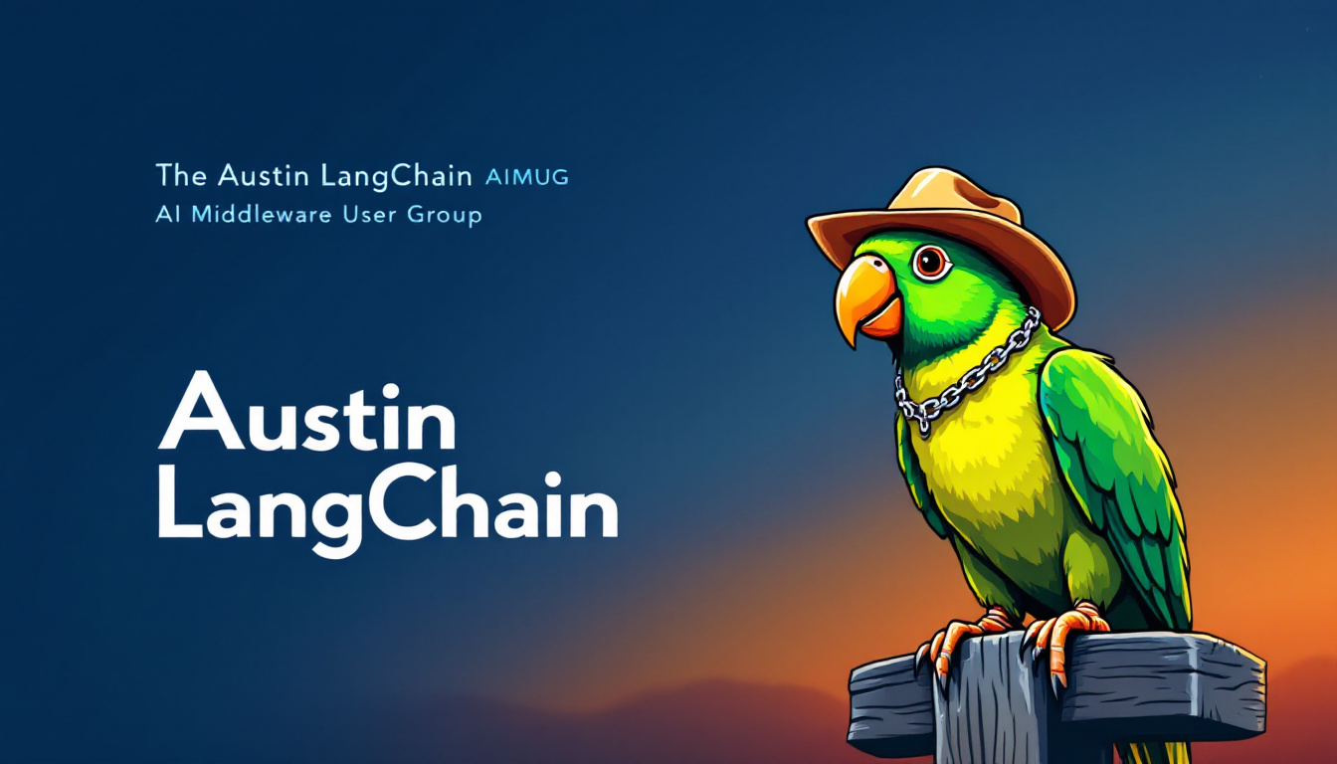

Slide 30
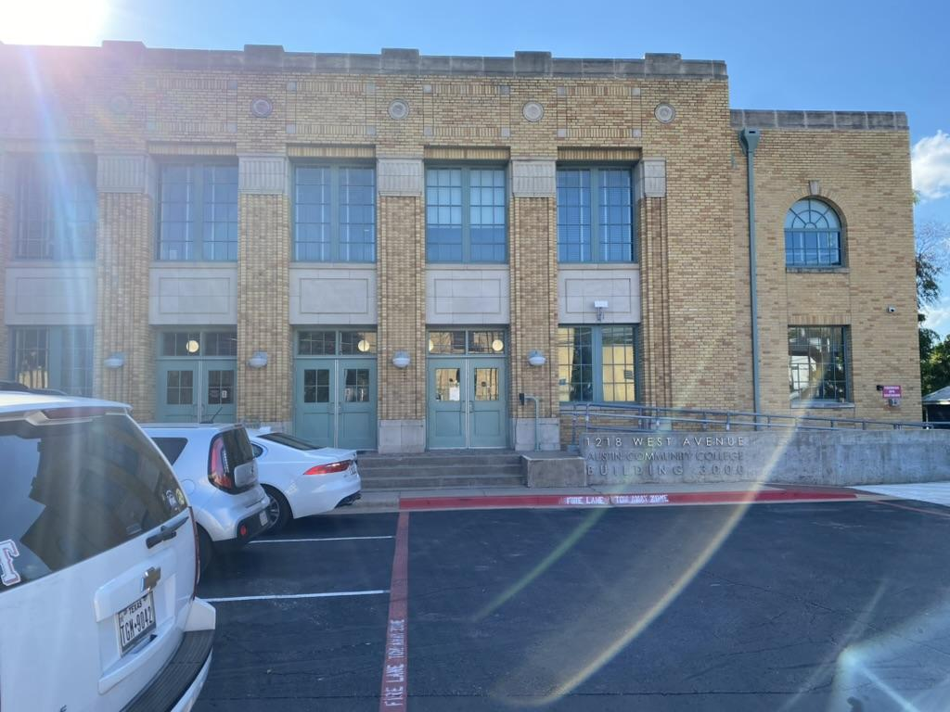
Finding US - ACC RGC-3000

Slide 31
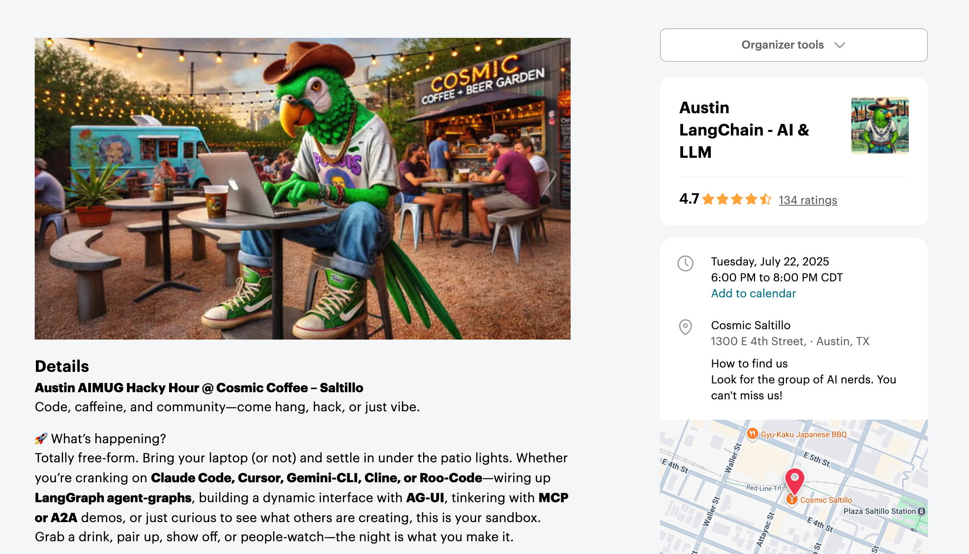
Next Event – Hacky Hour at Kinda Cosmic – July 22
Respect & Inclusivity: Our only rule is simple: “Be cool to each other, don’t be gross.”
AI Enthusiasts of All Levels Welcome: We celebrate diverse perspectives and unique paths in AI.

